Slide 1

Voluntary measures
A European movement towards self-determination?
European pathways for supporting and protecting adults: First results from the FL-EUR National reports
Katrine Kjærheim Fredwall
Paula Távora Vítor
Jordi Ribot Igualada

Slide 2
Programme
Continuing powers of attorney Katrine Kjærheim Fredwall
Advance directives Paula Távora Vítor
Other voluntary measures Jordi Ribot Igualada

Slide 3
Continuing powers (CPA), ordinary powers (OPA), advanced directives (AD) and other voluntary measures (OVM). How to distinguish?
Comparison based on number of voluntary measures in 26 jurisdictions
Difficulties in making clear distinctions between the different voluntary instruments
  The terms used, the contents of the measures and the interaction between them differ from country to country
  Language: “Lost in Translation”?
OPA
CPA
OVM
AD

Slide 4
‘Continuing powers of attorney’ in the FL-EUR National reports
European pathways for supporting and protecting adults: First results from the FL-EUR National reports
Katrine Kjærheim Fredwall

Slide 5

Continuing power of Attorney (CPA)
‘A mandate given by an adult with the purpose that it shall either be effective immediately, or enter into force in the future, and shall remain in force in the event of the granter’s incapacity’ (Rec 2009(11) – Pr. 2-1)
Should the definition also include the existence of safeguards (to apply (better) with CRPD)?

Slide 6
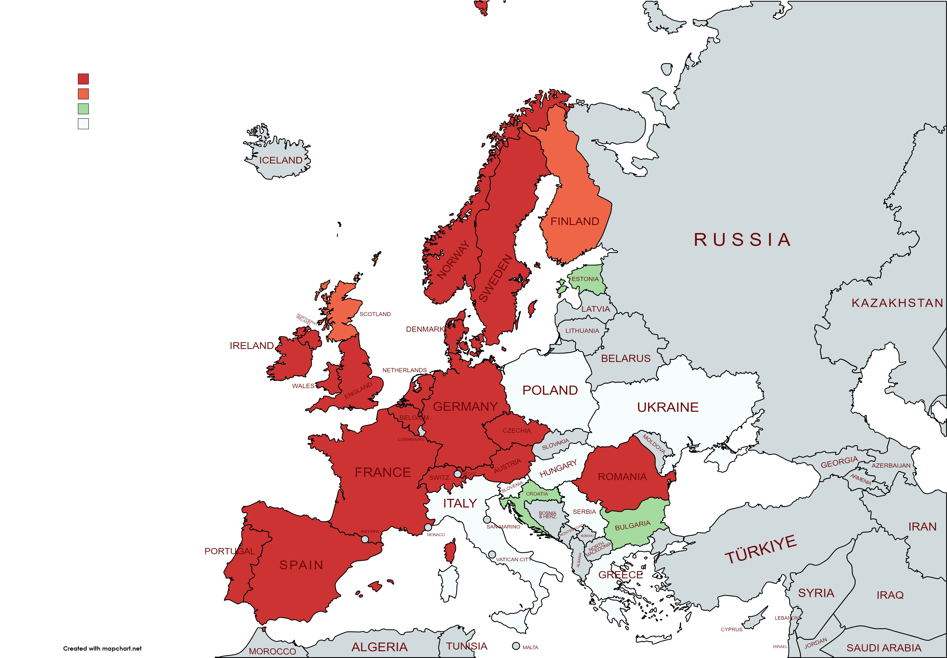
Continuing Powers of attorneys (CPAs) in Europe
26 jurisdictions assessed
CPAs more common in western parts of Europe.
CPA in the 20 coloured states
  Red: States (15) with comprehensive regulations on CPAs
  Orange: comprehensive regulations, but lacking data
  Green: Limited CPAs related to medical issues etc.
  White, assessed to be without regulations on CPAs, but often OPAs.
The further analyze is based on the 15 red states

Slide 7
What matters could be covered by the CPA?
8 states allow property and financial and personal and family matters.
  Highly personal matters as making a will are usually exempted.
7 states allow all matters – also including instructions related to medical treatment
  Austria
  Belgium
  England/Wales
  Germany
  The Netherlands
  Portugal
  Spain
Cf. Rec2009(11) principle 3

Slide 8
To what extent are the CPA and the wishes expressed within it legally binding?
The dominant answer is:
«Yes», the CPA is legally binding.
12 out of 15 states have confirmed that the measure is of a binding nature.
The Netherlands has claimed that the CPA are not legally binding, and England/Wales has given a more «nuanced» answer. Denmark has not answered.

Slide 9
… affects the legal capacity of the grantor?
Common core: (10/15):
The entry into force of the CPA do not affect the legal capacity of the grantor
2 states answer: «sometimes»: Austria and Switzerland
Ireland: «yes»
Cf. Rec2009(11) principle 9 – preservation of capacity

Slide 10
Q 42 e: «What are the criteria for decision-making (e.g. best interests of the adult or the will and preferences of the adult)?»
A possible common core (7 states):
The will and preferences of the adult
Unclear answers/unclear legal situation: 6 of the states.
Cf. CRPD article 12

Slide 11
Q 42 c: «is there a duty of the representative to inform and consult the adult?»
More uncertainty:
Only 4 out of 15 states confirm that the Attorney has a duty to inform and consult the adult:
  Austria
  Belgium
  Norway
  Sweden
Cf. Rec2009(11) principle 10-2 and CRPD art.12

Slide 12
Preliminary conclusions
Recommendation ERC/Rec(2009)11 of the Committee of Ministers to member states on principles concerning continuing powers of attorney and advance directives for incapacity seems to have been an important source for the states and have strengthen a common core.
CRPD has so far made a more “uncertain” footprint on European CPA-regulations.
This analyze is based on broad interpretations of the reports trying to grip the essential features of the legislations – many nuances are necessarily abandoned.

Slide 13
‘Advance Directives’ in the FL-EUR National reports
European pathways for supporting and protecting adults: First results from the FL-EUR National reports
Paula Távora Vítor

Slide 14
What are ‘Advance Directives’ (ADs)?
Principle 2 (3), Recommendation CM/Rec(2009)11 of the Committee of Ministers to member states on principles concerning continuing powers of attorney and
advance directives for incapacity
Advance directive: instructions given or wishes made by a capable adult concerning issues that may arise in the event of his or her incapacity

Slide 15
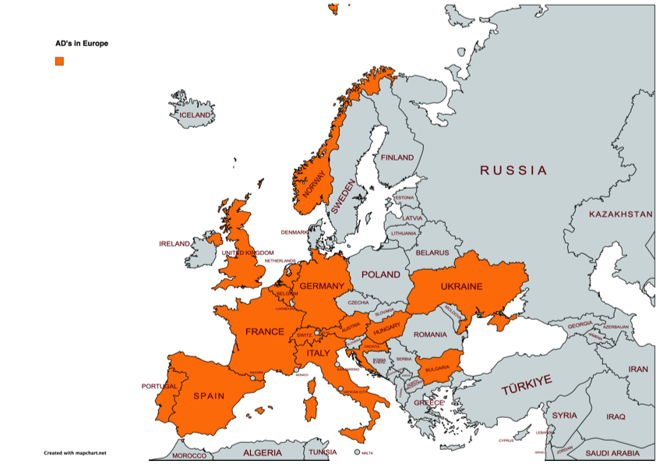
ADs in Europe
27 jurisdictions assessed
15 jurisdictions have ADs
27 different ADs (most jurisdictions have more than one type of AD)
Countries from different cultural backgrounds
More common in Western Europe

Slide 16
What types of AD exist?
Criterion: Recipient of the AD
11 ADs: addressed to the health care provider
8 ADs: addressed to the Court
2 ADs: addressed to the representative/support person
2 ADs: addressed to the Court and to the representative/support person
2 ADs: addressed to the Court, to the representative/support person and others
1 AD: addressed to the health care provider and to the representative/support person
1 AD: addressed to the Guardianship Authority

Slide 17
Which matters are covered?
List of matters:
9 ADs: Appointment of representative/support person
9 ADs: Medical matters (general)*
2 ADs: Medical matters (refusal of medical treatment)
2 ADs: Medical matters (end of life)
2 ADs: Instructions to the representative/support person
1 AD: Appointment of representative/support person + definition of scope and orientation of support measure
1 AD: Record of values, beliefs and wishes
* Special regime: Euthanasia AD (ND)

Slide 18
To what extent is the AD legally binding?
7 ADs: legally binding (no exceptions)
12 ADs: legally binding (exceptions)
5 ADs: not legally binding*
3 ADs: no answer
* 3 appointment of rep/support person; 1 values and beliefs; 1 instructions

Slide 19
Does the entry into force of the AD affect the legal capacity of the adult?
19 ADs: legal capacity not affected
8 Ads: No answer
The legal capacity is not identified as being affected in any jurisdiction.

Slide 20
Some remarks
What types of AD exist? (Art. 12 (3) UNCRPD + Preamble 14.; Principle 1 Rec(2009)11))
Which matters are covered? (Principle 14 Rec(2009)11)). Prevalence of medical matters.
To what extent is the AD legally binding? (Principle 15 Rec(2009)11))
Does the entry into force of the AD affect the legal capacity of the adult? Common core (cf. Art. 12 (2) UNCRPD; no reference to AD in Rec(2009)11)

Slide 21
‘Other voluntary measures’ in the FL-EUR National reports
European pathways for supporting and protecting adults: First results from the FL-EUR National reports
Jordi Ribot Igualada

Slide 22
Introduction
Beyond CPAs and ADs
  Anticipatory voluntary measures <-> Measures designating currently needed support

Slide 23
Introduction
Beyond CPAs and ADs
  Anticipatory voluntary measures <-> Measures designating currently needed support
  Voluntary supported decision-making measures

Slide 24
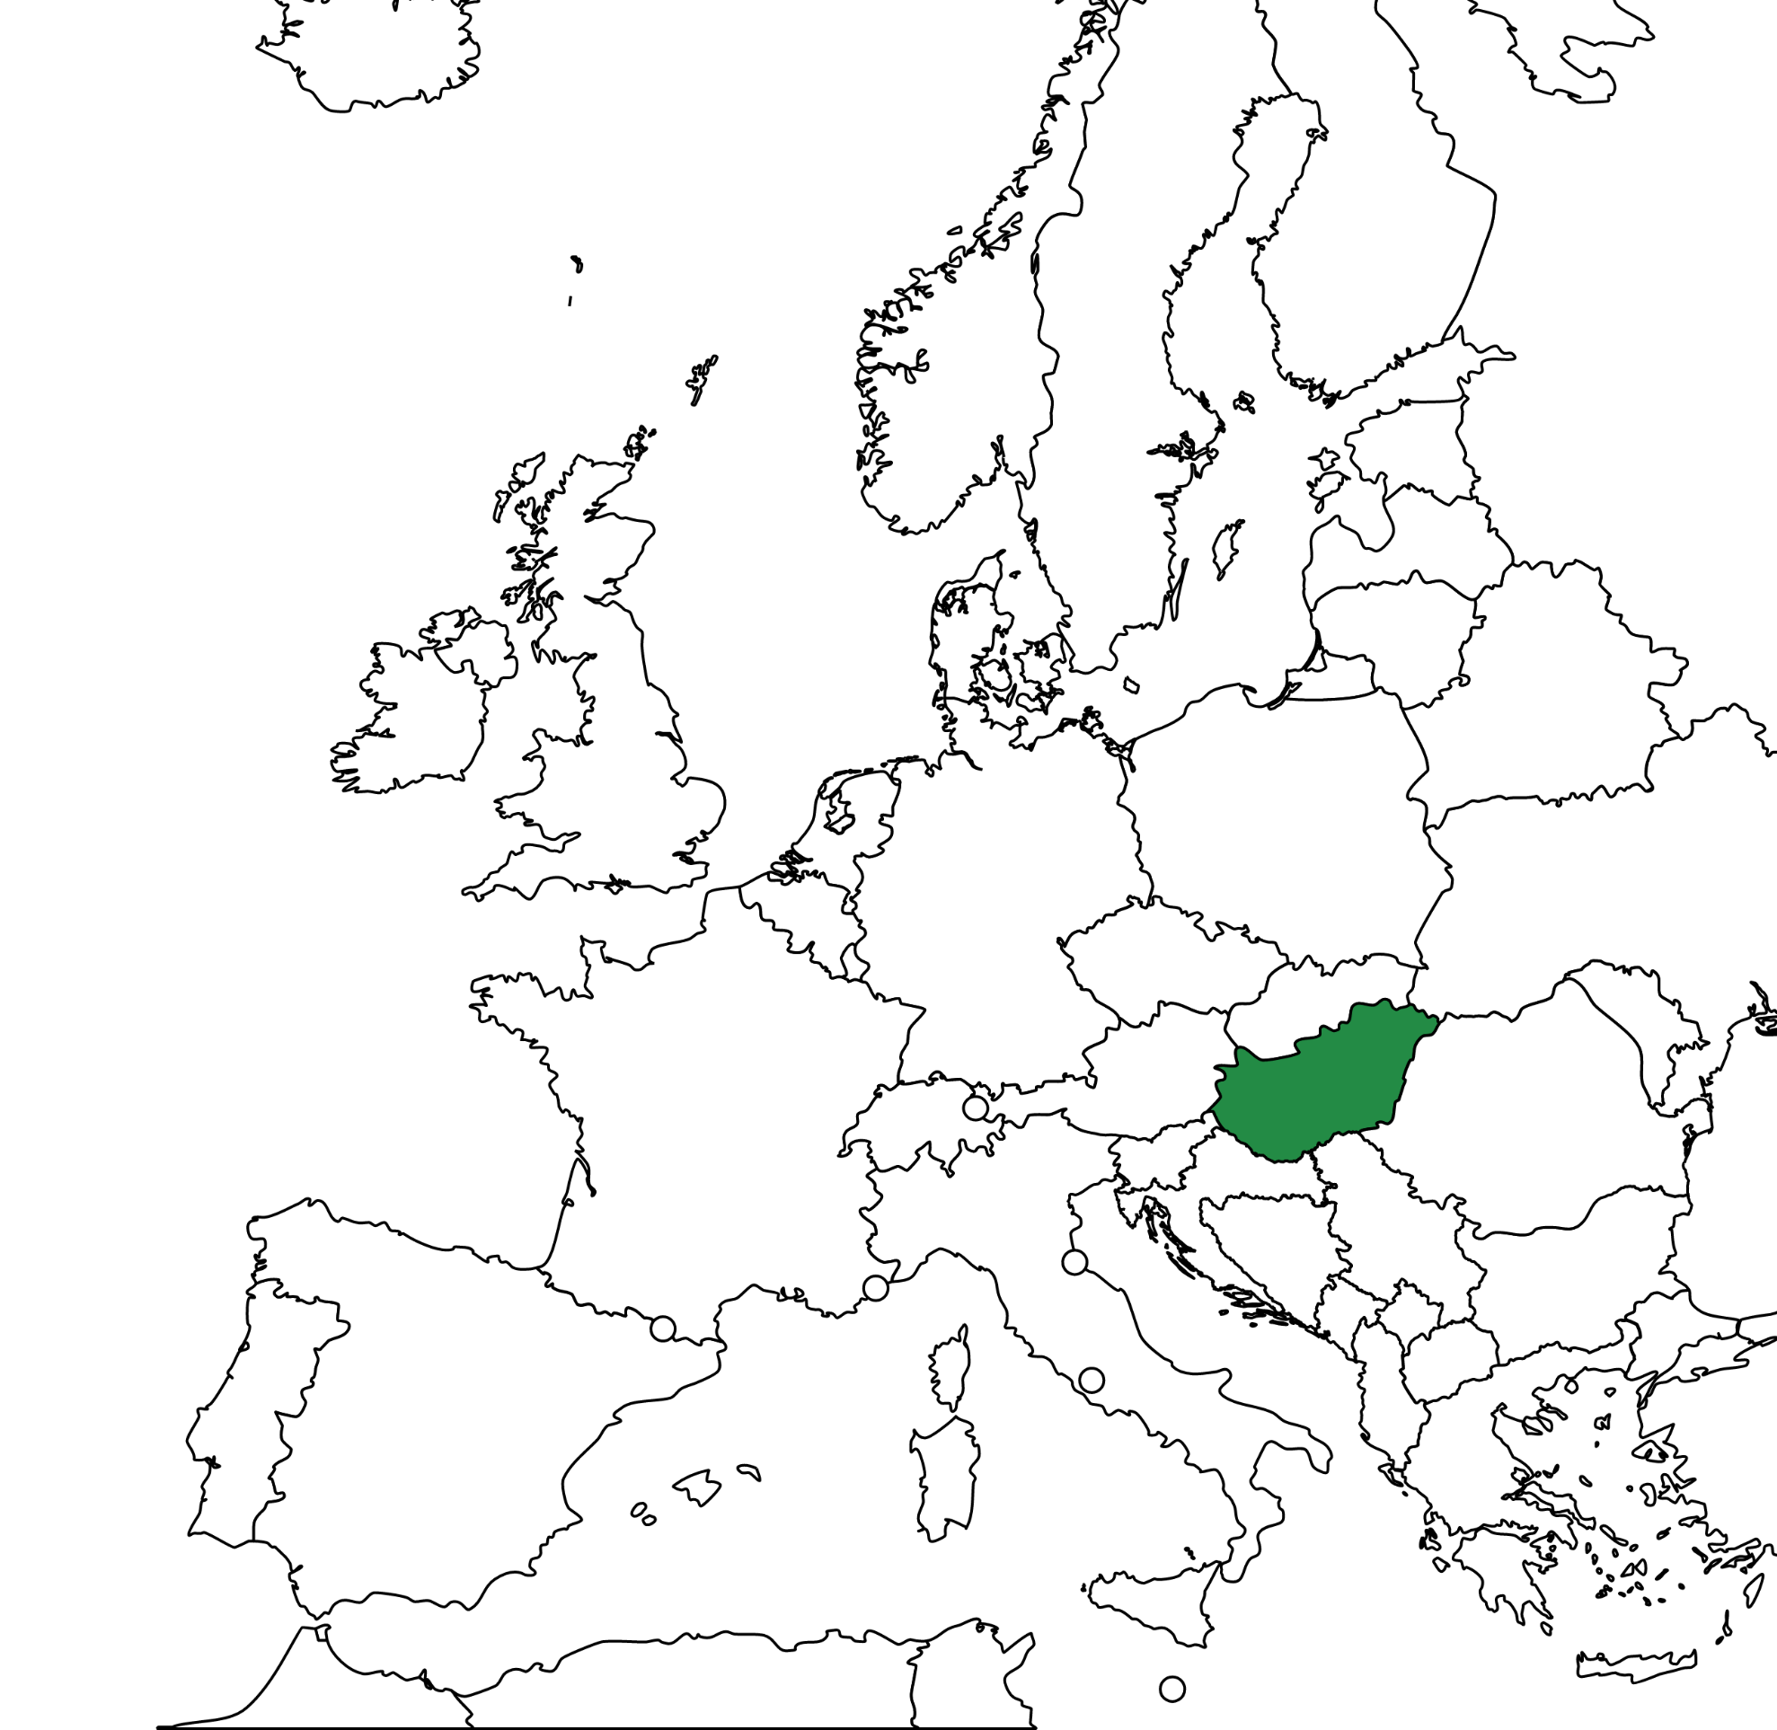
Voluntary supported decision-making measures
Hungarian law on supported decision-making (támogatott döntéshozatal) 2013

Slide 25
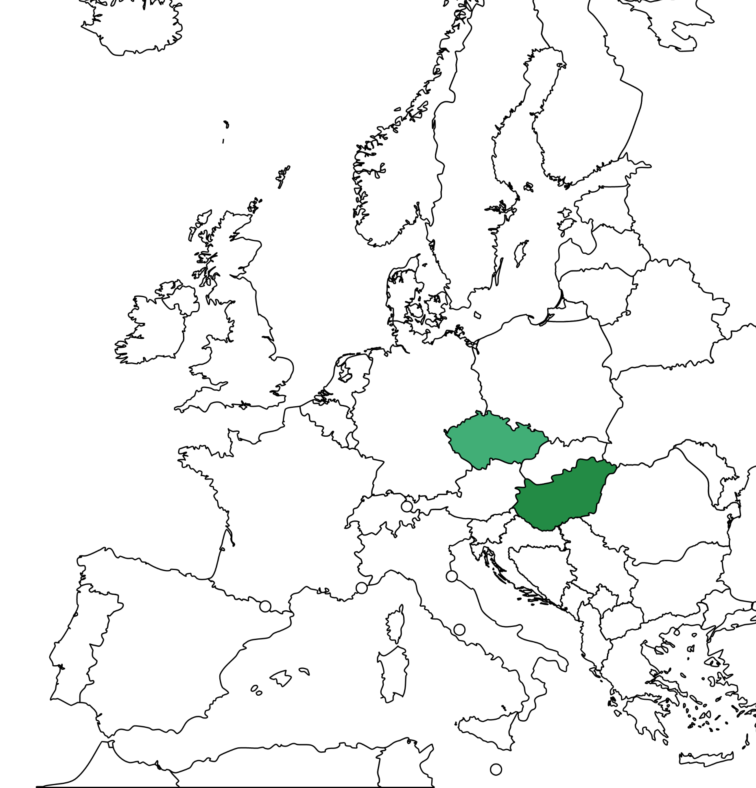
Voluntary supported decision-making measures
Hungarian law on supported decision-making (támogatott döntéshozatal) 2013
Provisions on assisted decision-making (nápomoc při rozhodování) of the Czech CC 2014

Slide 26
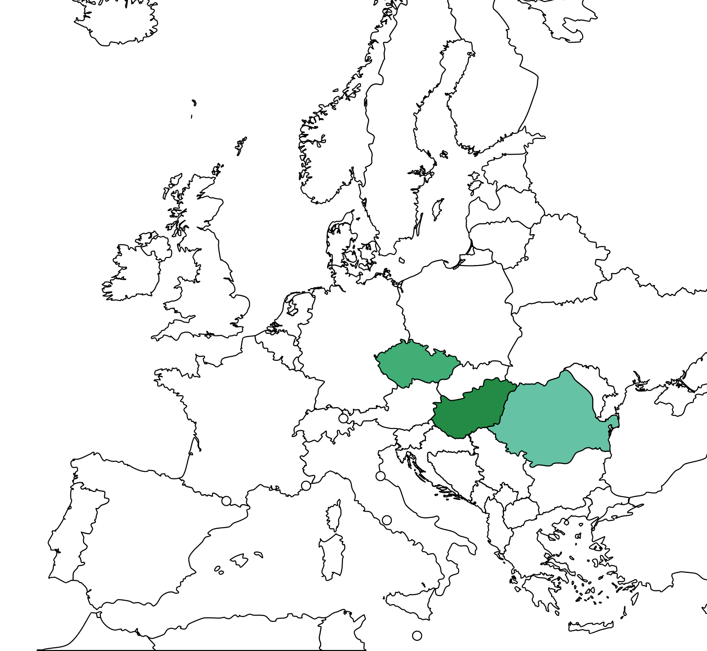
Voluntary supported decision-making measures
Hungarian law on supported decision-making (támogatott döntéshozatal) 2013
Provisions on assisted decision-making (nápomoc při rozhodování) of the Czech CC 2014
Romanian asistenta judiciara 2022

Slide 27
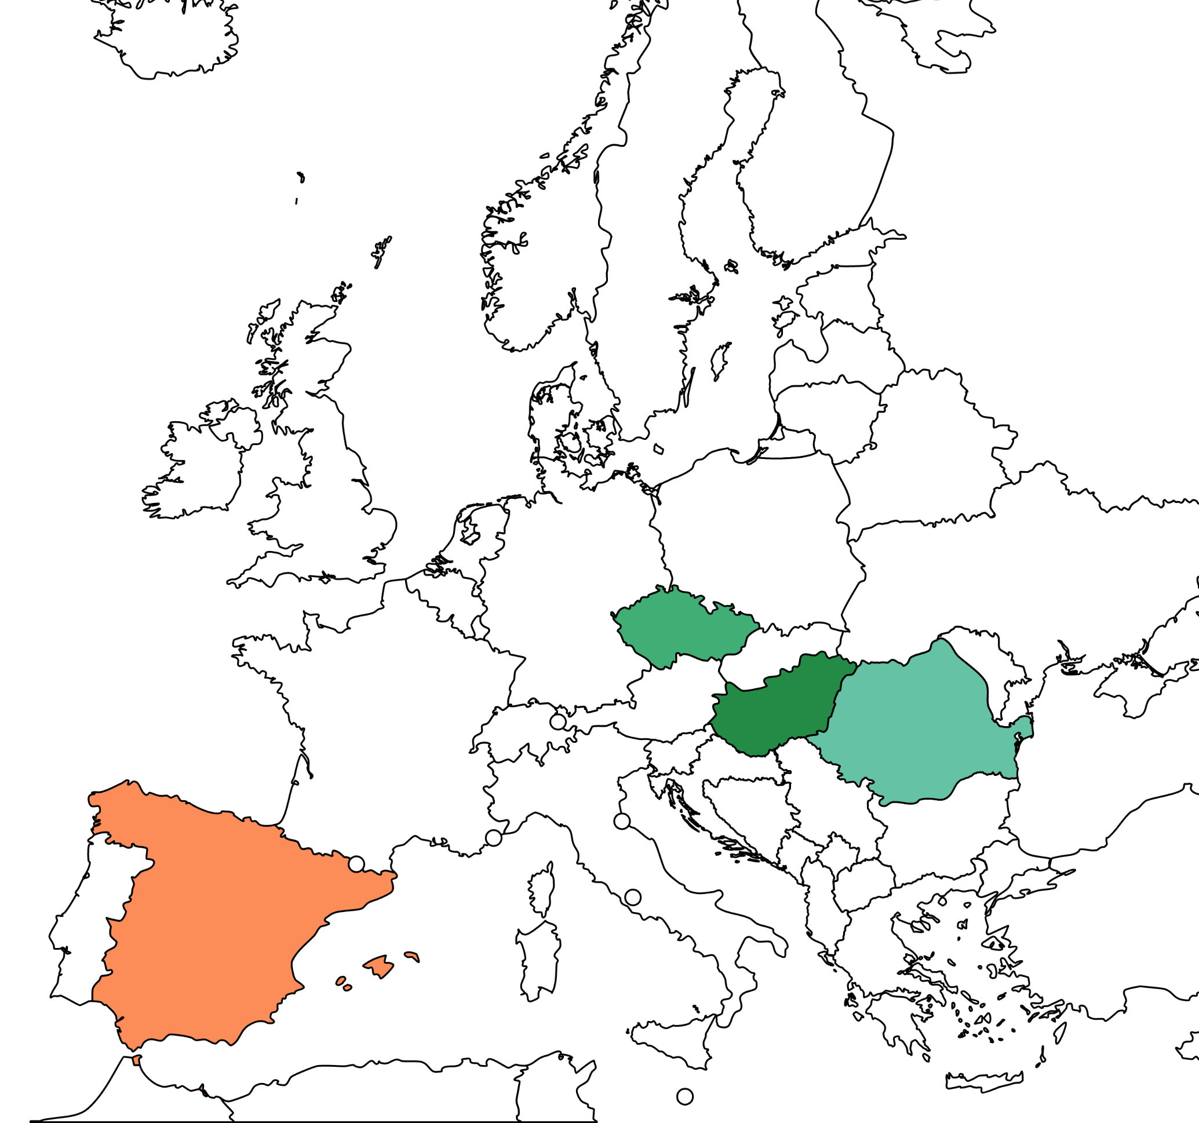
Voluntary supported decision-making measures
Hungarian law on supported decision-making (támogatott döntéshozatal) 2013
Provisions on assisted decision-making (nápomoc při rozhodování) of the Czech CC 2014
Romanian asistenta judiciara 2022
Spanish jurisdictions (acuerdos de apoyo) 2022

Slide 28
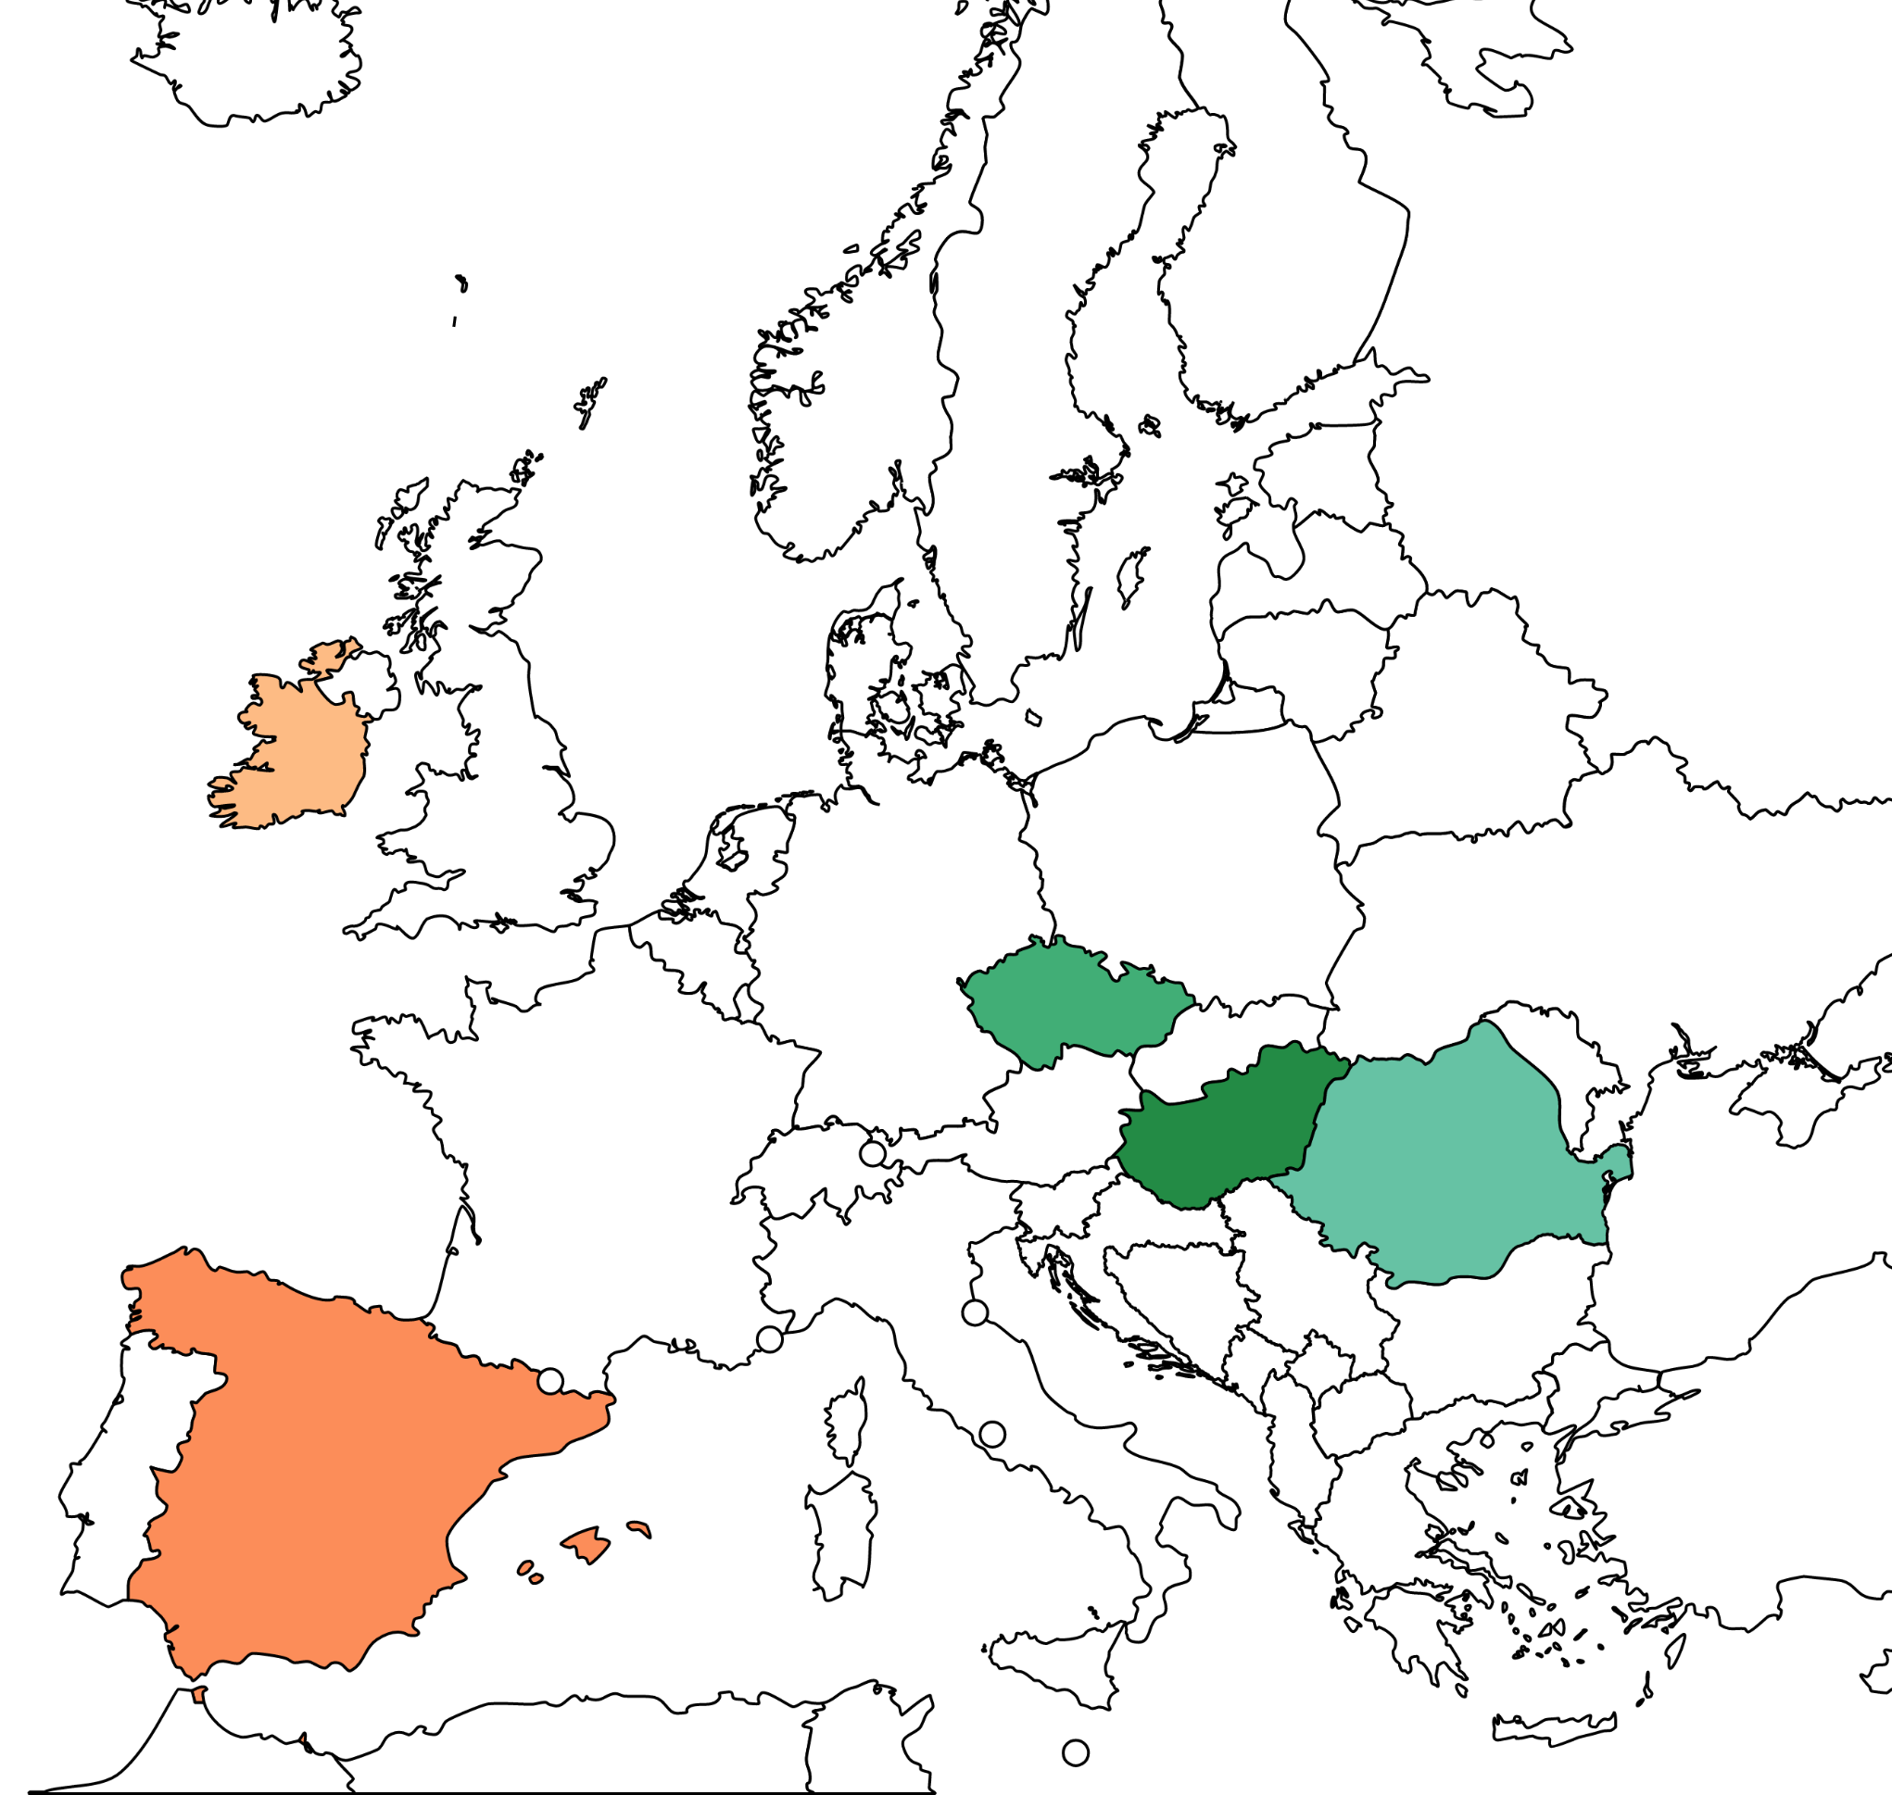
Voluntary supported decision-making measures
Hungarian law on supported decision-making (támogatott döntéshozatal) 2013
Provisions on assisted decision-making (nápomoc při rozhodování) of the Czech CC 2014
Romanian asistenta judiciara 2022
Spanish jurisdictions (acuerdos de apoyo) 2022
Ireland (Decision-making assistance agreement and Codecision making agreement) 2022

Slide 29
Who is the supported person?
 |  | Adult | Supporter | Function | Form | Effects | Variation Revocation | Safeguards
CZECH REP.
HUNGARY
ROMANIA
SPAIN
IRELAND | DMA
 | CDM
adult who need assistance in decision-making due to complications resulting from their mental disorder
adult ‘who needs help in managing their affairs and making decisions due to a minor diminution in their decision-making abilities’
adult with full legal capacity [who] need support for taking care of themselves, their assets or more in general in exercising their rights and assuming obligations
adult who appreciates their need for support
adult who considers that his or her capacity is in question or may shortly be in question

Slide 30
Who can be supporter
 |  | Adult | Supporter | Function | Form | Effects | Variation Revocation | Safeguards
CZECH REP.
HUNGARY
ROMANIA
SPAIN
IRELAND | DMA
 | CDM
a suitable natural person, without conflicts of interest
a natural person at the adult’s request, or by default a court appointed professional
a relative or friend of the appointer who has had such personal contact with the appointer over such period of time that a relationship of trust exists between them

Slide 31
Supporter’s function
 |  | Adult | Supporter | Function | Form | Effects | Variation Revocation | Safeguards
CZECH REP.
HUNGARY
ROMANIA
SPAIN
IRELAND | DMA
 | CDM
the support person (1) is present, with the consent of the supported person when the supported person makes legal acts; (2) procures the necessary data and information to make such a legal act and (3) provides advice to the supported person concerning their legal acts
They must be present at administrative, civil and criminal proceedings in which the supported person is involved, consult with them …, and be present when the supported person declares rights. They facilitate the making of the legal declaration, providing their advice and the information necessary, but also ‘contributing with their presence’. At the request of the supported person or the guardianship authority, the supporter shall record in writing the help they provided to the supported person and the advice they had given.
The support person’s task is to ‘transmit and receive information on behalf of the adult and… communicate to third parties the decisions taken by them’ …. The support persons do not conclude legal acts on behalf of the adults nor approve their acts

Slide 32
Supporter’s function
As specified in the decision-making assistance agreement, the decision-making assistant shall
(a) assist the appointer to obtain the appointer’s relevant information,
(b) assist the appointer by explaining relevant information and considerations relating to a relevant decision,
(c) ascertain the will and preferences of the appointer on a matter the subject or to be the subject of a relevant decision and assist the appointer to communicate them,
(d) assist the appointer to make and express a relevant decision, and
(e) endeavour to ensure that the appointer’s relevant decisions are implemented.
A decision-making assistant shall not make a decision on behalf of the appointer.
 |  | Adult | Supporter | Function | Form | Effects | Variation Revocation | Safeguards
CZECH REP.
HUNGARY
ROMANIA
SPAIN
IRELAND | DMA
 | CDM
…/…
(d) discuss with the appointer the known alternatives and likely outcomes of a relevant decision,
(e) make a relevant decision jointly with the appointer
A relevant decision being made jointly means that a co-decision-maker (a) shall acquiesce with the wishes of the appointer in respect of the relevant decision, and (b) shall not refuse to sign the document, unless it is reasonably foreseeable that such acquiescence or signature, as the case may be, will result in serious harm to the appointer or to another person.

Slide 33
Formalities
 |  | Adult | Supporter | Function | Form | Effects | Variation Revocation | Safeguards
CZECH REP.
HUNGARY
ROMANIA
SPAIN
IRELAND | DMA
 | CDM
can be executed in writing, or… directly before a court
by the guardianship authority upon adult’s request
approved by a public notary upon a joint request of both parties
executed before a public notary
*to be determined by regulation and orders
in writing, witnessed and complying with regulations

Slide 34
Enter into force
 |  | Adult | Supporter | Function | Form | Effects | Variation Revocation | Safeguards
CZECH REP.
HUNGARY
ROMANIA
SPAIN
IRELAND | DMA
 | CDM
upon approval by the court
upon approval of the guardianship authority
immediate, but lasting two years only
immediate
*to be determined by regulation and orders
upon approval of the agreement’s registration by the Director of the Decision Support Service

Slide 35
Variation or revocation
 |  | Adult | Supporter | Function | Form | Effects | Variation Revocation | Safeguards
CZECH REP.
HUNGARY
ROMANIA
SPAIN
IRELAND | DMA
 | CDM
Either party can apply to end the agreement
At the request of the adult, before expiry of its term
revoked by either party and also varied, subject to agreement

Slide 36
Safeguards
 |  | Adult | Supporter | Function | Form | Effects | Variation Revocation | Safeguards
CZECH REP.
HUNGARY
ROMANIA
SPAIN
IRELAND | DMA
 | CDM
external judicial ex post control, removal
The guardianship authority must review the appointment every five years
The support must report to the guardianship authority annually and when ending the term
Annually reporting to the Director of the Support Decision Service and review at least every 3 years

Slide 37
Comparative outline
Jurisdictions | Only four countries have specific regulations on SDM agreements (CZ, H, ROM, IRE), and one merely mentions them (E)
Commonalities | Bilateral legal acts involving always an adult in need of support or assistance
 | The functions of the support person range from merely being present in legal acts to providing advice, all regulations focusing on enhancing the adult’s decision-making skills and their chances to form a will and it being communicated
 | Acting on behalf of the adult is excluded
 | Revocation at will by either party at any time
Particularities | IRE has a highly developed set of rules, still to be deployed with regulations and orders, including requirements for the support person, and co-decision-making agreements, which entail restrictions to the adult’s legal agency in particular instances
Divergences as to form, requirements to enter into force and safeguards | E and R require a notarial deed and afford immediate effects; CZ and H subject legal effects to the approval by a public authority; IRE requires witnessed writing and approval of registration by the public authority
 | Inexistant safeguards in both CZ and E; limited in H and R, and intense in IRE
Practical experience | Null in R, IRE and E due to recent reforms; in CZ the practice is marginal; in H it is simply ignored

