Slide 1


PARIS IS STILL FAR …
grant applications and impact
Kees Boersma
Faculty of Social Sciences
Department of Organization Sciences
f.k.boersma@vu.nl
1

Slide 2
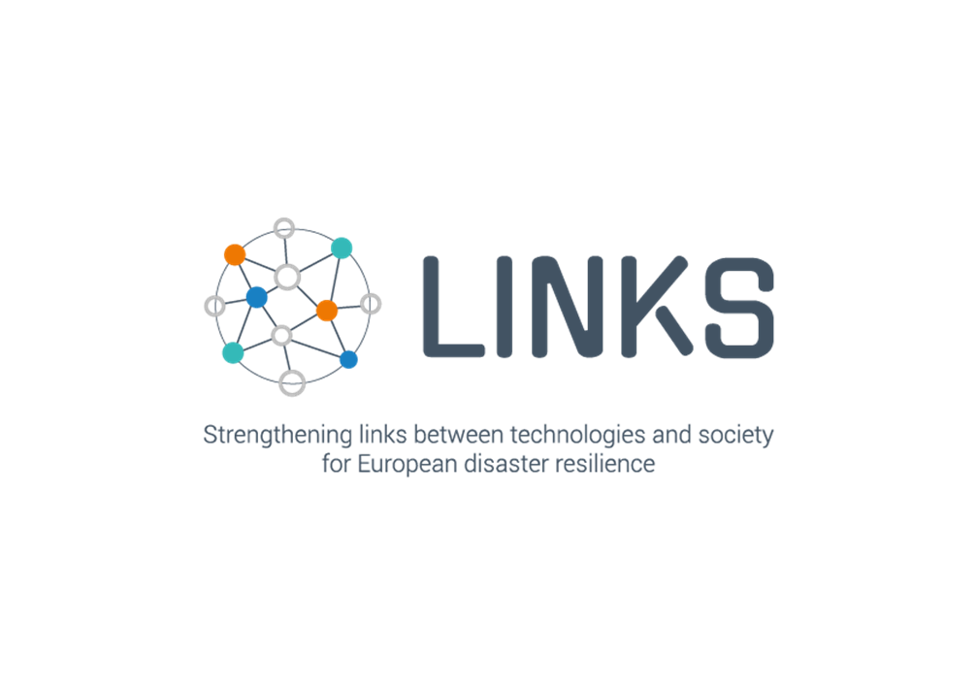

we regret to inform you that …
Dear Madam/Sir,
I am writing in connection with your proposal for the above-mentioned call.
Having evaluated your proposal, we regret to inform you that, despite its merits, it can unfortunately not be funded because the score obtained does not suffice, given the budgetary resources available for the call.
But on February 2021:

Slide 3
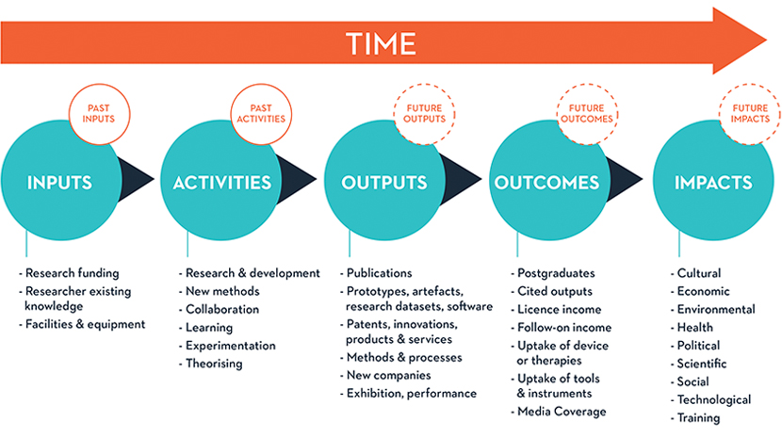
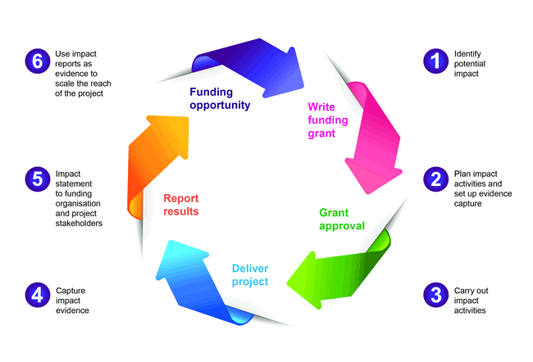
The bumpy road towards a successful grant
Thinking about impact is important in all phases of grant writing:
What is your story?
What does the call text say?
How can you contribute to broader societal/research agenda’s?
The bumpy road:
What is the impact you would like to achieve
The consortium that is needed
The approach

Slide 4
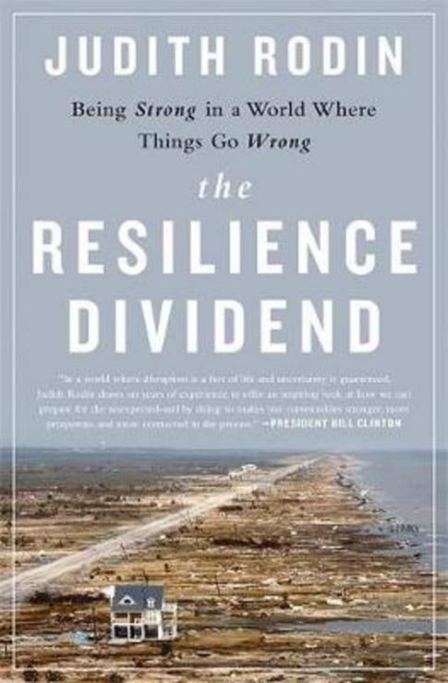
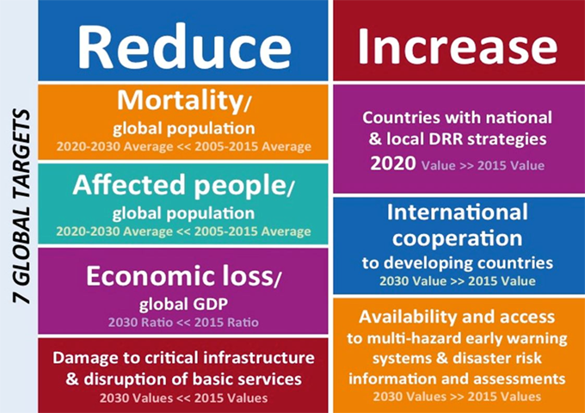
Where is the fit between your research and broader agendas
Contribution to + blind spots of those agendas
Critical voices are needed (be convincing)
Social scientists not as fixers but as part of an integrated perspective
Sendai Framework
100 resilient cities

Slide 5
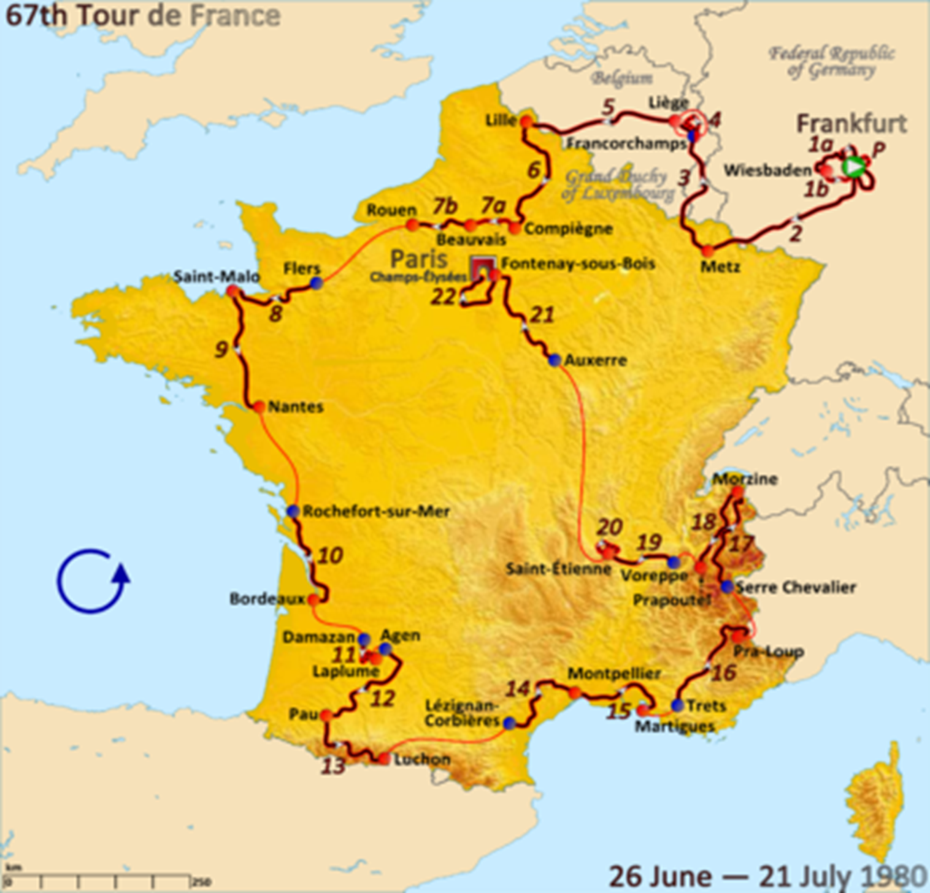
what is your contribution to the impact that is asked for
The call text is important:
Use the right terminology and make sure ‘everything’ from the call text is covered, but:
Think about the originality of your proposal, and
Make the project do-able (because the EU will check if you keep your promises!)

Slide 6
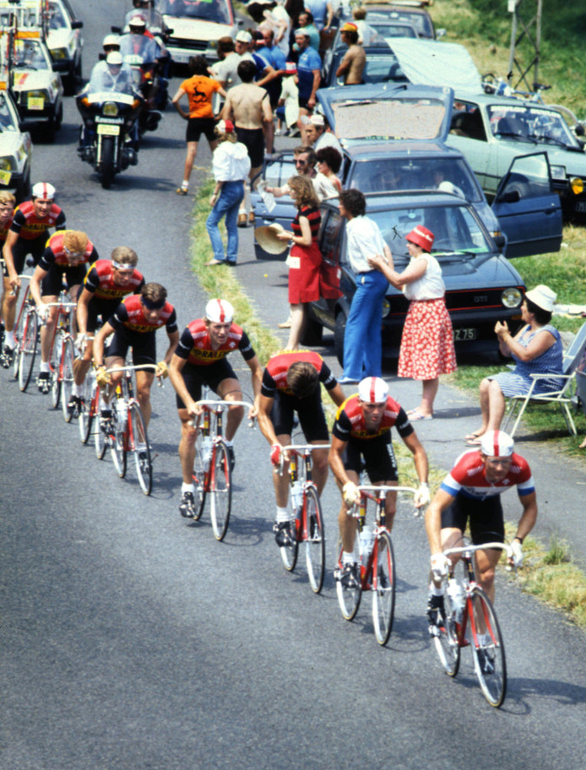
put the right team together
Impactful networks of partners (diversity)
Ideally: build/join consortia with partners you worked with before, or:
Use the networks of the people you worked with before
Try to develop a ‘chain’: use a project to write new proposals
Use your expert knowledge (niche) to join consortia

Slide 7
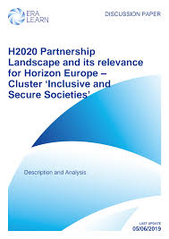
Horizon 2020 Framework Programme for Research and Innovation (2014-2020)
Call: Human factors, and social, societal, and organisational aspects for disaster-resilient societies.
Sub-issues to be addressed are the diversity in risk perception, in vulnerabilities and in understanding responses to crises to propose new approaches and strategies for communities’ awareness, leadership, and crisis management regarding threats of both natural disaster and terror.
First responders and authorities are invited to propose strategies, processes and methods.

Slide 8


Slide 9













Health Emergency Response in Interconnected Systems

Slide 10
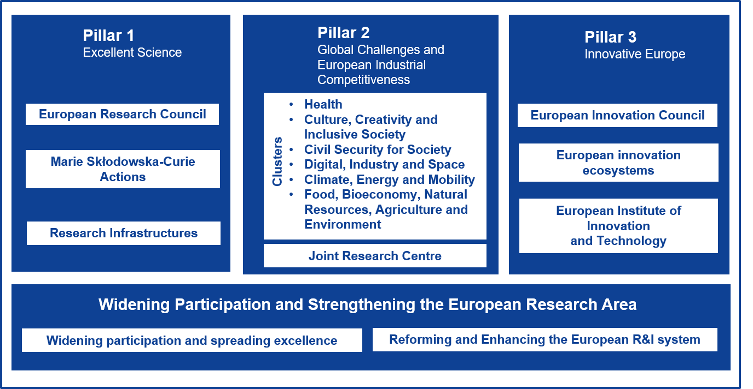
Horizon Europe
Disaster-Resilient Society for Europe. This Destination supports the implementation of international policy frameworks (e.g. the Sendai Framework for Disaster Risk Reduction, the Paris Agreement, Sustainable Development Goals), EU disaster risk management policies tackling natural and man-made threats (either accidental or intentional), European Green Deal priorities including the new EU Climate Adaptation Strategy ….

Slide 11
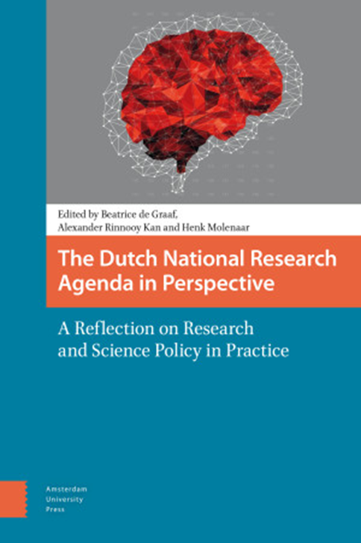
NWO AGENDA resilient societies

Slide 12
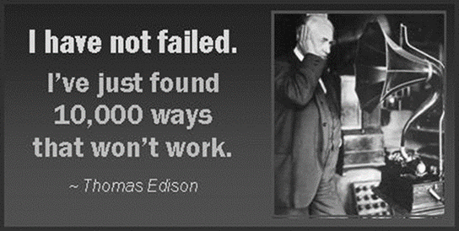
discussion
Linking your research to broader agendas
Think about outcomes and impact
Shape a consortium with partners you can trust
Make it doable

